Slide 1



HEART HEALTH CLASSIFICATION USING HEARTBEAT AUDIO
A Project by :
P. Satish Sarma
18BEC0397

Slide 2
INTRODUCTION
Heart disease is the leading cause of death globally, resulting in more people dying every year due to cardiovascular diseases (CVDs) compared to any other cause of death.
Currently, there are two effective ways to monitor one's heart condition; electrocardiogram (ECG) and echocardiogram. However, both methods are relatively expensive for mass inspection and require technical expertise in using them.

Slide 3
OBJECTIVE
The goal of this project is to develop a reliable, fast and low-cost system that can be used by untrained frontline health workers or anyone with internet access, to help determine whether an individual should be referred for expert diagnosis, particularly in areas where access to clinicians and medical care is limited. This will also help in early diagnosis of CVDs which will drastically decrease the potential risk factors of these deaths.

Slide 4
DATASET USED
The Dataset used here is:
Bentley, P. and Nordehn, G. and Coimbra, M. and Mannor, S
The {PASCAL} {C}lassifying {H}eart {S}ounds {C}hallenge 2011 {(CHSC2011)}
http://www.peterjbentley.com/heartchallenge/index.html
Which consists of various types of heartbeats, both normal and abnormal, which we will use to train our classifier model.

Slide 5
CODE AND WORKING PRINCIPLE: A WALKTHROUGH

Slide 6
PREPROCESSING

Slide 7
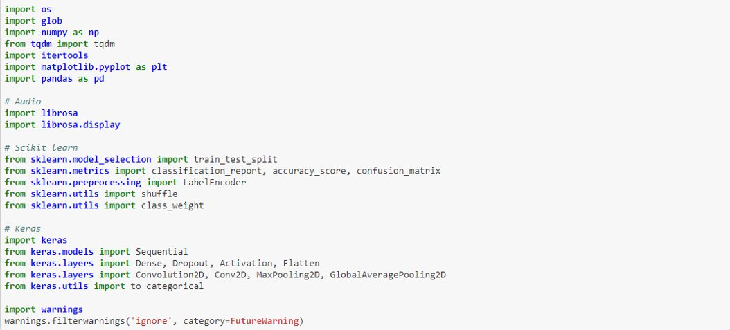
IMPORTING THE NECESSARY LIBRARIES

Slide 8
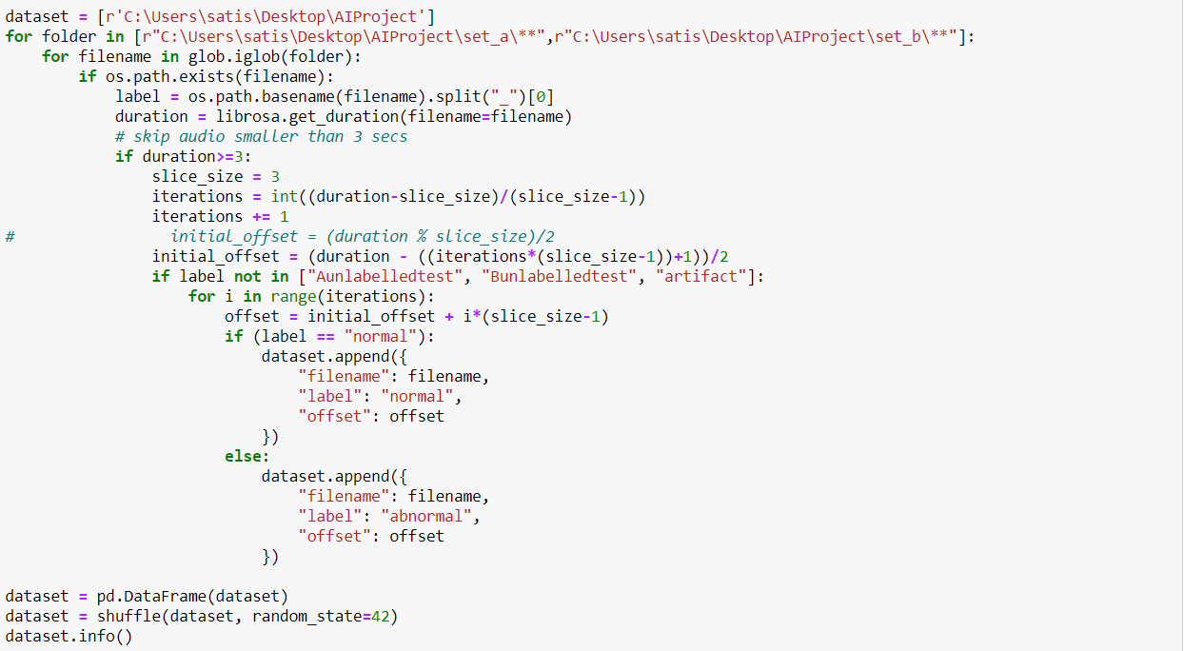
READING AND LABELLING IN THE DATASET

Slide 9
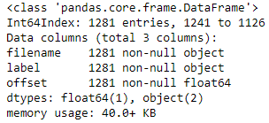
INFO ABOUT THE DATASET

Slide 10
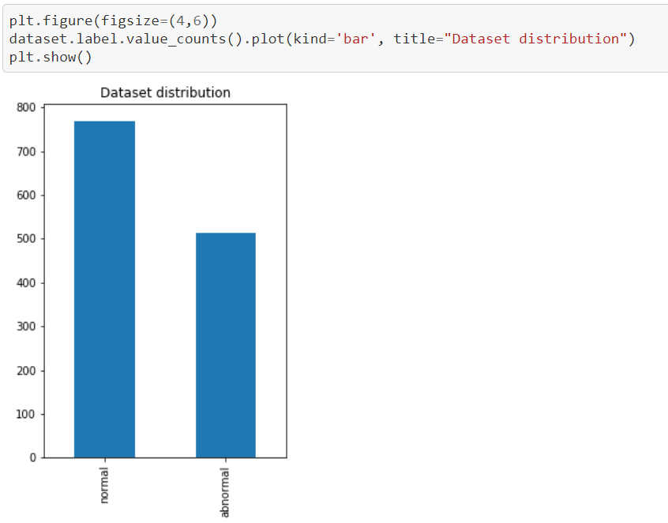
DISTRIBUTION OF DATA IN THE DATASET

Slide 11
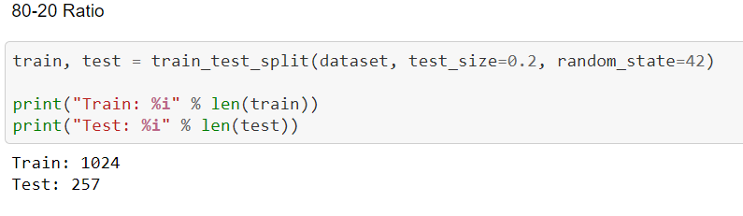
SPLITTING THE DATASET

Slide 12
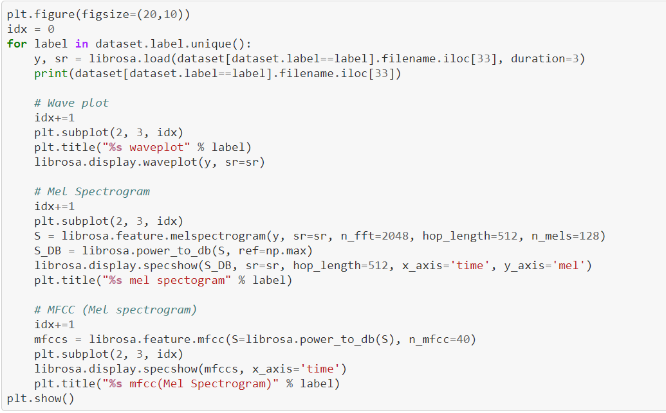
VISUALISING THE DATASET

Slide 13
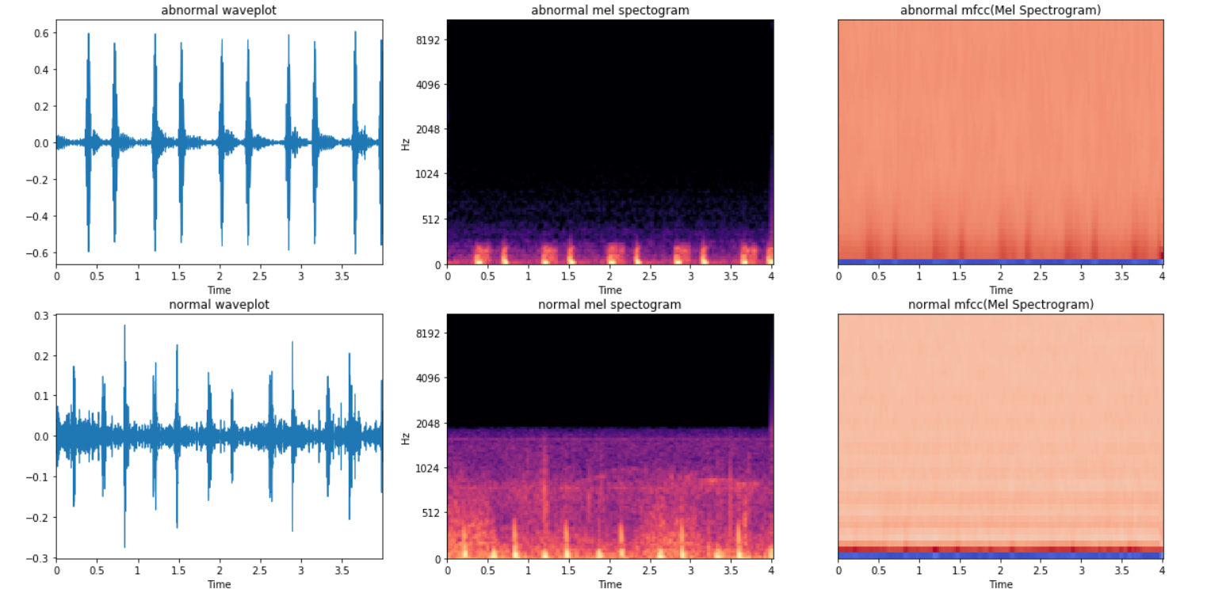

Slide 14
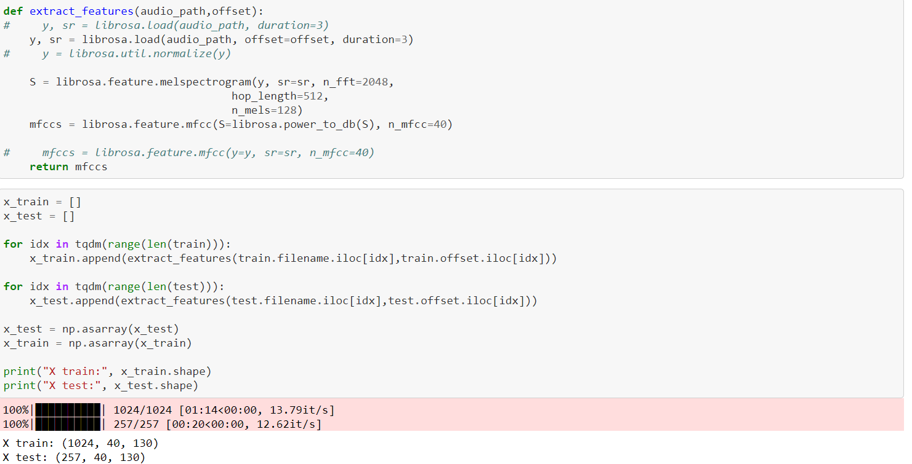
DATA FOR TRAINING AND TESTING SETS

Slide 15
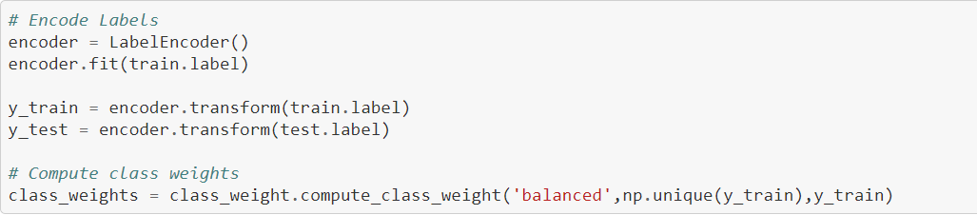
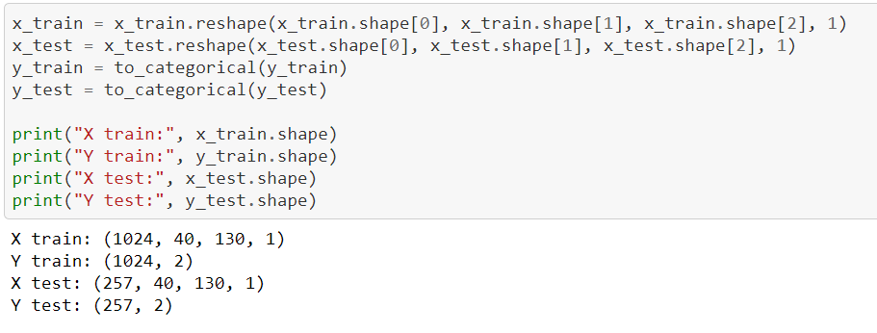
SIZE OF TESTING AND TRAINING SETS

Slide 16
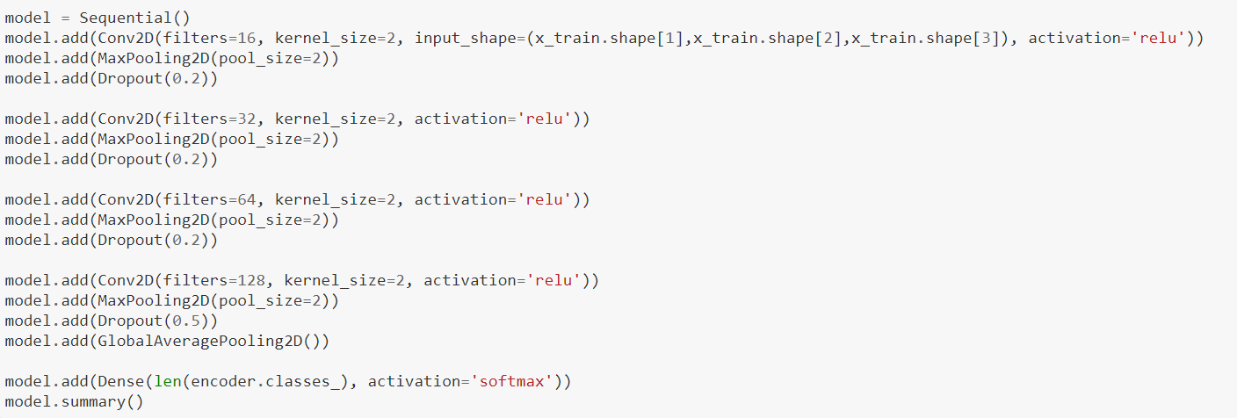
BUILDING THE MODEL

Slide 17
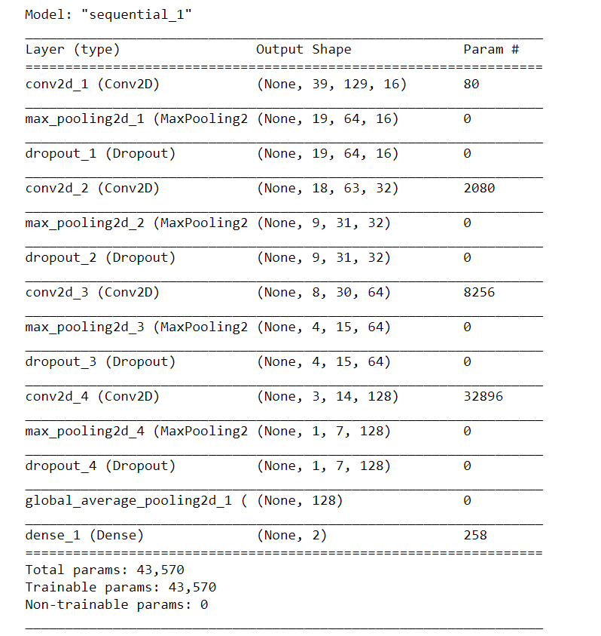
CREATED MODEL

Slide 18
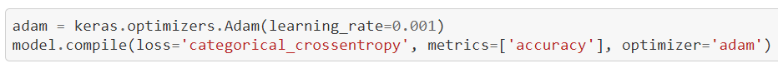
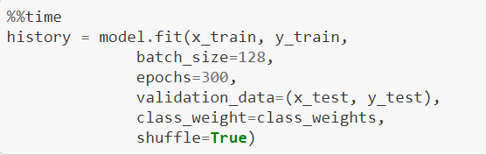
COMPILING AND FITTING THE MODEL

Slide 19
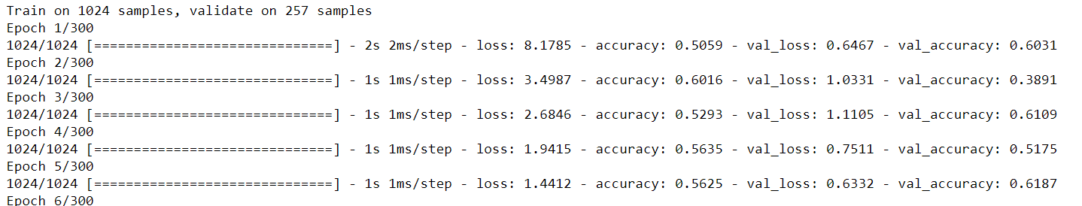
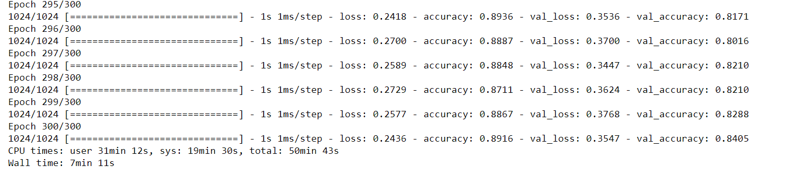
TRAINING PROCESS
.
.
.
.

Slide 20
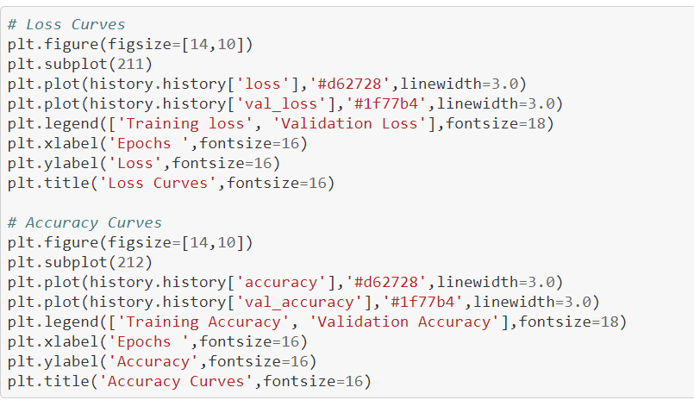
FINDING ACCURACY AND LOSS OF MODEL

Slide 21
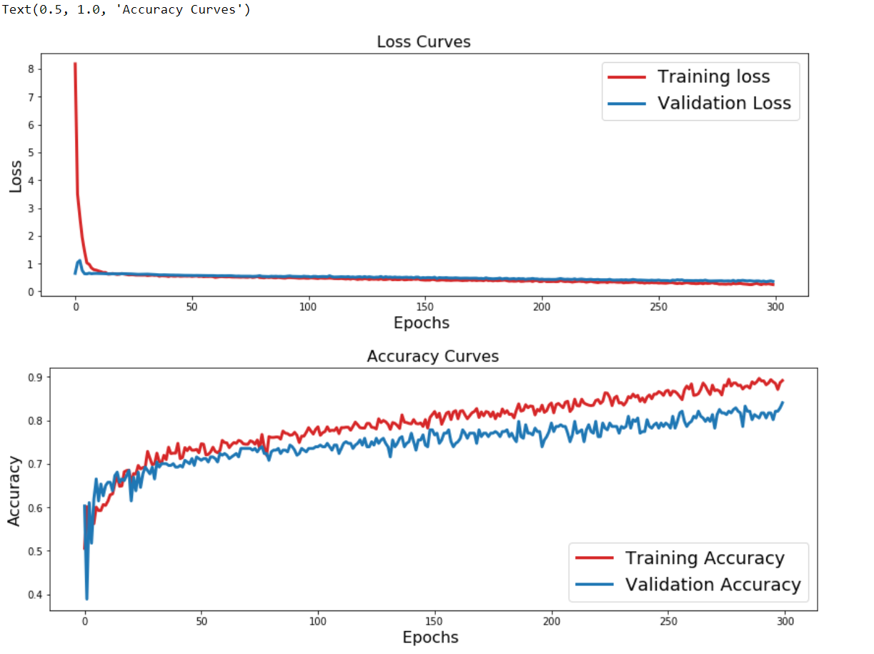
ACCURACY AND LOSS VISUALIZATION

Slide 22
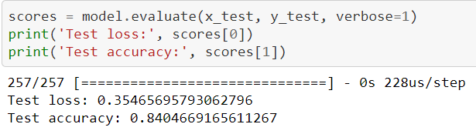
ACCURACY AND LOSS CALCULATION

Slide 23
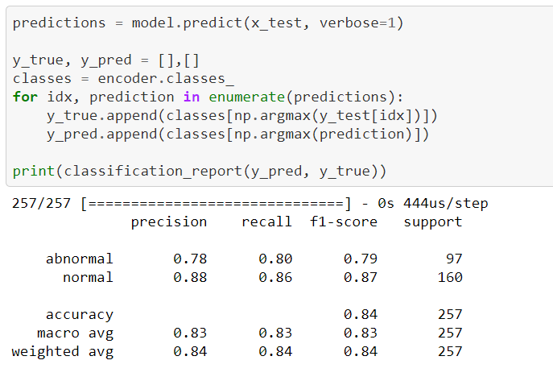
APPLICATIONON OF MODEL ON TESTING SET

Slide 24
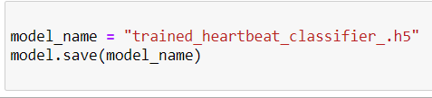
SAVING THE CREATED MODEL

Slide 25
IMPLEMENTATION

Slide 26
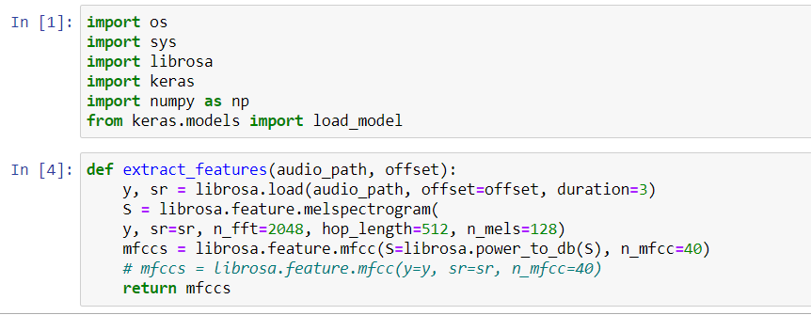
MAIN CODE
IMPORTING REQUIRED LIBRARIES

Slide 27
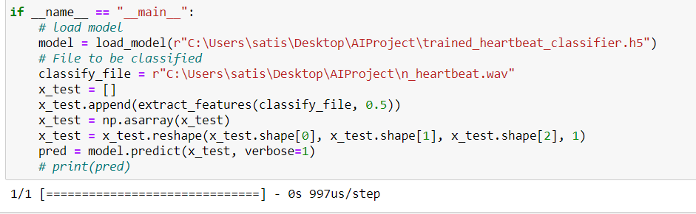
CALLING IN THE CLASSIFIER MODEL
AND THE AUDIO TO BE CLASSIFIED
Here we have used random heartbeat audios for the final model to classify, obtained from the following database:
https://depts.washington.edu/physdx/heart/demo.html

Slide 28
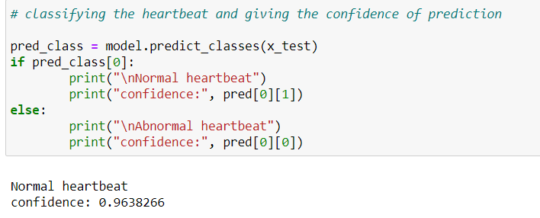
PREDICTION

Slide 29
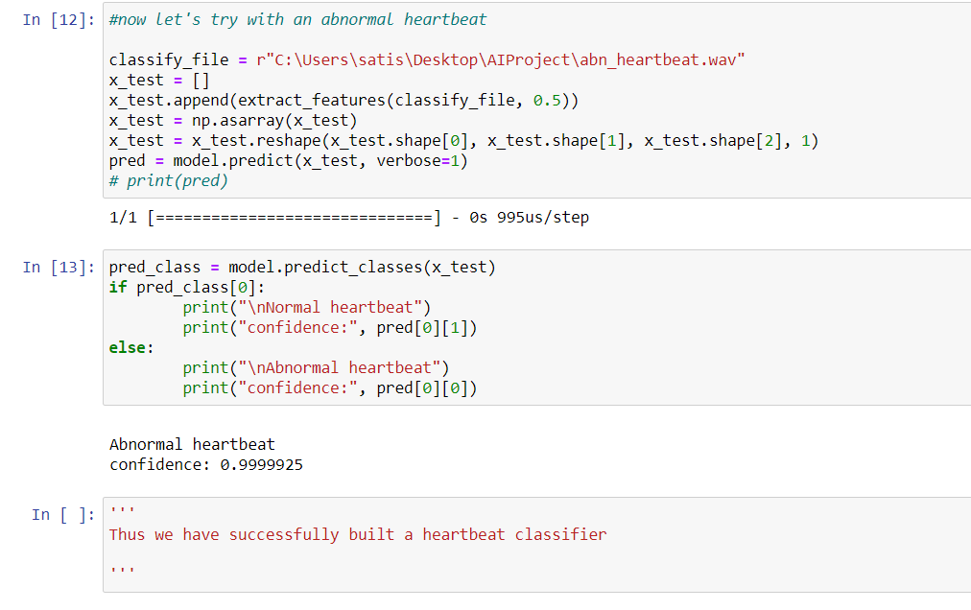
WHEN HEARTBEAT IS ABNORMAL

Slide 30
FUTURE SCOPE / ADVANCEMENTS
Due to the ability of this project to quickly classify the heartbeat condition of a patient, this can be used as a fast and efficient way to get to know whether a patient needs to attend a heart doctor's appointment , or if it is unnecessary at the moment (not urgent).
This work can be combined with the general heart health classification which uses other factors such as the patient's height, weight, BMI, blood pressure, etc to give a quick and detailed description of the patient's condition, which could be of ease to the doctors, and also help in saving time for the doctor, and saving expenses for the patient

Slide 31
CONCLUSION
Thus the design of a successful Heart health classifier based on the Heartbeat of a person has been done
Ability to predict abnormality in a heartbeat with high accuracy makes this model have a huge potential for advancements and practical uses.

Slide 32
REFERENCES
Hardi Rathod, Pratik Kumar Singh, Nikita Tikone, Suresh Babu
"Heart Health Classification and Prediction Using Machine Learning ,"
https://www.irjet.net/archives/V7/i3/IRJET-V7I3262.pdf
Heart sound segmentation using deep learning:
https://www.analyticsvidhya.com/blog/2017/11/heart-sound-segmentation-deep-learning/

Slide 33
THANK YOU

